Slide 1
Member segmentation usage profiling
Blake Abbenante
7/11/16

Slide 2
Why we are here today
History of CRM at Zipcar
Gaps in understanding the member base
Data deep-dive & demystification

Slide 3
overview
GOAL:
Create standard language for understanding the multiple ways we look at the member base
Lifecycle
Business Segment
Badging
Member Attributes
(Usage) Profile
Create repeatable (automated) process for profiling North American Zipcar Members that will allow us:
Infer reasons for changes in market behavior
Judge the effectiveness of the marketing efforts
Target subgroups of the member base

Slide 4
RECAp: first round
Exploratory analysis of aggregate driving behavior
Logistic Regression Modeling to predict Likelihood to Drive
Recency is the key predictor
Linear Regression Model to predict Number of Trips
Recency is a strong indicator
Number of trips in previous 6 months also a strong
RFM analysis

Slide 5
Next steps
Further exploration of individual driving patterns
Time to first drive
Time to nth drive
Span of activity window
Reconsideration of RFM framework

Slide 6
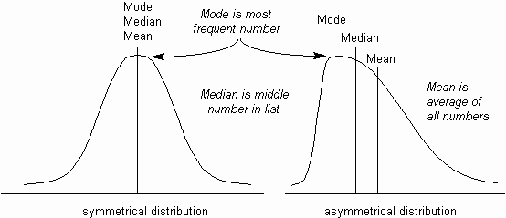
BUT FIRST…A QUICK DIGRESSION on averages
We field a lot of questions about ‘average drivers’ or ‘average trips’ or ‘average number of x’.
In this context, average is generally synonymous with ‘representative’ – but average is only representative if the underlying distribution of the population is normal.

Slide 7
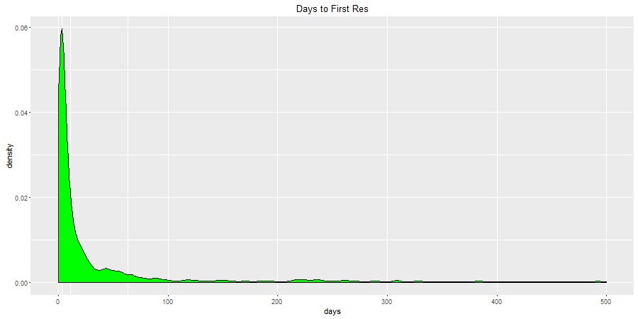
BUT FIRST…A QUICK DIGRESSION on averages
For example, Time to First Trip is extremely positively skewed:
The average time to first drive is 63 days.
The median time to first drive is 11 days.
The mode time to first drive is 1 day
1 day
11 days
60 days
242 days

Slide 8
The fallacy of the quarterly driver
Combining a few of these misconceived statistics together with anecdotal examples gives you an unrealistic view of member behavior.
“The average member drives 4 times a year”
“Many members have occasional (but consistent) use cases – driving every few months”
The number of members who driving history extends at least a year and who’s behavior exhibits these characteristics lies somewhere between:
0.4% (strictest interpretation – 3 successive trips 90+ days apart after any single reservation)
5.5% (liberal interpretation – 50% of (non-consecutive) driving quarters have a trip 60+ days from previous trip).

Slide 9
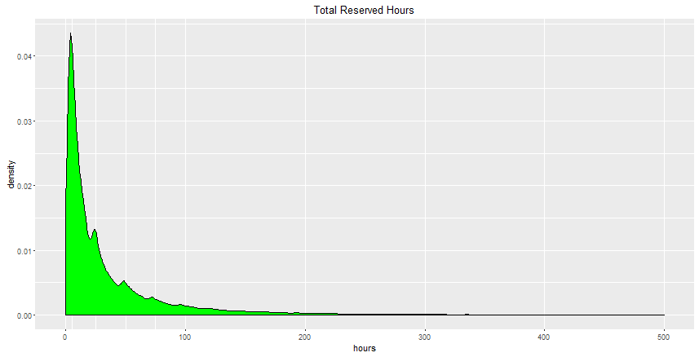
Data exploration (Reservation hours)
A similar distribution occurs when looking at hours/member. We have chosen to swap out revenue for hours as they are highly correlated (r=0.913), and hours can help normalize rate discrepancies across market and vehicle class.

Slide 10
Data exploration
With that in mind, let’s re-examine the way member’s behave when the use zipcar
Are there discernable patterns when members onboard?
Are there discernable patterns when members attrite?
What is a good ‘pace’ of reservation?

Slide 11
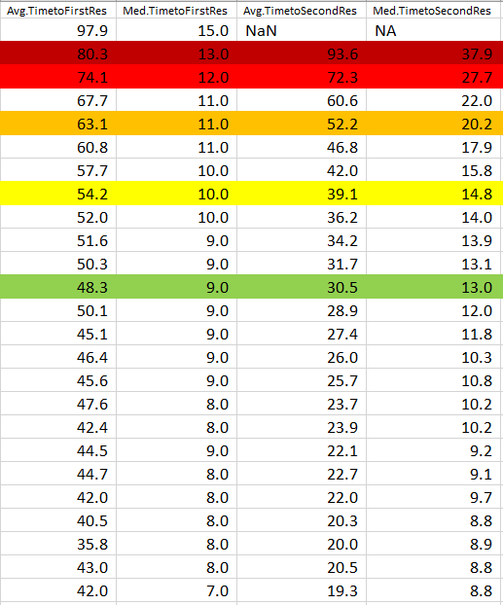
Data exploration (time between reservation)
Total_Res | Members | Avg.Res.Span | Med.Res.Span | Avg.TimeToNextRes.Avg | Avg.TimeToNextRes.Med | Med.TimeToNextRes.Avg | Med.TimeToNextRes.Med | Avg.TimetoFirstRes | Med.TimetoFirstRes | Avg.TimetoSecondRes | Med.TimetoSecondRes | Avg.TimetoMiddleRes | Med.TimetoMiddleRes | Avg.TimetoLastRes | Med.TimetoLastRes
1 | 139,478 | - | - | NaN | NA | NaN | NA | 97.9 | 15.0 | NaN | NA | NaN | NA | NaN | NA
2 | 90,591 | 93.6 | 37.9 | 93.6 | 37.9 | 93.6 | 37.9 | 80.3 | 13.0 | 93.6 | 37.9 | NaN | NA | 93.6 | 37.9
3 | 66,131 | 156.0 | 103.9 | 78.0 | 52.0 | 78.0 | 52.0 | 74.1 | 12.0 | 72.3 | 27.7 | NaN | NA | 83.7 | 36.1
4 | 50,911 | 198.7 | 155.0 | 66.2 | 51.7 | 47.8 | 28.0 | 67.7 | 11.0 | 60.6 | 22.0 | 60.6 | 22.0 | 74.0 | 33.1
5 | 41,072 | 232.9 | 195.9 | 58.2 | 49.0 | 42.0 | 30.0 | 63.1 | 11.0 | 52.2 | 20.2 | 52.2 | 20.2 | 67.8 | 30.7
6 | 33,820 | 259.2 | 229.3 | 51.8 | 45.9 | 33.4 | 22.8 | 60.8 | 11.0 | 46.8 | 17.9 | 48.5 | 19.4 | 61.8 | 28.0
7 | 28,549 | 280.8 | 255.0 | 46.8 | 42.5 | 29.8 | 22.6 | 57.7 | 10.0 | 42.0 | 15.8 | 43.2 | 17.1 | 59.1 | 27.0
8 | 24,411 | 298.6 | 280.0 | 42.7 | 40.0 | 25.9 | 19.9 | 54.2 | 10.0 | 39.1 | 14.8 | 39.0 | 16.4 | 54.3 | 24.9
9 | 20,832 | 312.7 | 298.9 | 39.1 | 37.4 | 23.7 | 18.8 | 52.0 | 10.0 | 36.2 | 14.0 | 35.7 | 14.7 | 50.9 | 23.1
10 | 18,171 | 329.4 | 323.1 | 36.6 | 35.9 | 21.6 | 17.0 | 51.6 | 9.0 | 34.2 | 13.9 | 33.8 | 14.2 | 49.0 | 21.9
11 | 15,782 | 337.8 | 333.1 | 33.8 | 33.3 | 19.8 | 16.1 | 50.3 | 9.0 | 31.7 | 13.1 | 30.5 | 13.9 | 45.9 | 20.9
12 | 14,129 | 349.3 | 349.7 | 31.8 | 31.8 | 18.3 | 14.8 | 48.3 | 9.0 | 30.5 | 13.0 | 29.0 | 12.9 | 43.4 | 19.6
13 | 12,635 | 358.1 | 361.5 | 29.8 | 30.1 | 17.4 | 14.4 | 50.1 | 9.0 | 28.9 | 12.0 | 27.1 | 12.1 | 41.3 | 18.1
14 | 11,150 | 367.6 | 372.7 | 28.3 | 28.7 | 16.1 | 13.9 | 45.1 | 9.0 | 27.4 | 11.8 | 25.9 | 12.1 | 40.5 | 17.4
15 | 10,051 | 373.4 | 383.7 | 26.7 | 27.4 | 15.4 | 13.2 | 46.4 | 9.0 | 26.0 | 10.3 | 23.8 | 11.0 | 38.6 | 17.0
16 | 9,015 | 382.6 | 394.9 | 25.5 | 26.3 | 14.4 | 12.8 | 45.6 | 9.0 | 25.7 | 10.8 | 23.1 | 11.0 | 37.4 | 16.1
17 | 8,150 | 393.1 | 409.1 | 24.6 | 25.6 | 14.0 | 12.5 | 47.6 | 8.0 | 23.7 | 10.2 | 22.5 | 10.6 | 36.0 | 15.9
18 | 7,504 | 397.0 | 418.6 | 23.4 | 24.6 | 13.2 | 11.9 | 42.4 | 8.0 | 23.9 | 10.2 | 20.8 | 9.8 | 34.8 | 15.0
19 | 6,623 | 402.1 | 417.9 | 22.3 | 23.2 | 12.7 | 11.4 | 44.5 | 9.0 | 22.1 | 9.2 | 19.7 | 9.2 | 33.9 | 15.0
20 | 6,264 | 408.7 | 434.7 | 21.5 | 22.9 | 12.2 | 10.9 | 44.7 | 8.0 | 22.7 | 9.1 | 19.4 | 9.0 | 33.7 | 14.1
21 | 5,769 | 411.4 | 436.0 | 20.6 | 21.8 | 11.8 | 10.5 | 42.0 | 8.0 | 22.0 | 9.7 | 17.9 | 8.2 | 31.9 | 14.0
22 | 5,206 | 417.2 | 443.9 | 19.9 | 21.1 | 11.3 | 10.0 | 40.5 | 8.0 | 20.3 | 8.8 | 18.2 | 8.1 | 31.3 | 14.0
23 | 4,862 | 420.2 | 452.8 | 19.1 | 20.6 | 11.0 | 10.0 | 35.8 | 8.0 | 20.0 | 8.9 | 17.7 | 8.0 | 31.0 | 13.9
24 | 4,603 | 428.0 | 468.1 | 18.6 | 20.4 | 10.7 | 9.3 | 43.0 | 8.0 | 20.5 | 8.8 | 15.7 | 7.6 | 29.4 | 12.9
25 | 4,082 | 430.6 | 468.6 | 17.9 | 19.5 | 10.2 | 9.0 | 42.0 | 7.0 | 19.3 | 8.8 | 16.1 | 7.8 | 29.3 | 12.7
Looking at the median value instead of the average value, it is apparent that time to second reservation is a much better indicator of future activity than time to first reservation.

Slide 12
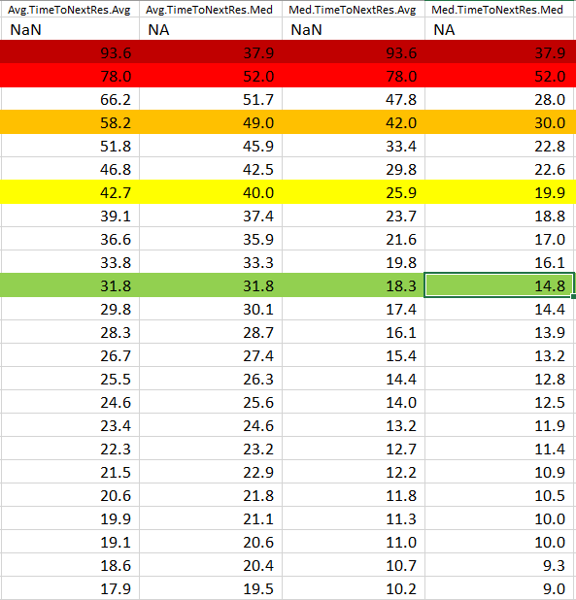
Data exploration (time between reservation)
Total_Res | Members | Avg.Res.Span | Med.Res.Span | Avg.TimeToNextRes.Avg | Avg.TimeToNextRes.Med | Med.TimeToNextRes.Avg | Med.TimeToNextRes.Med | Avg.TimetoFirstRes | Med.TimetoFirstRes | Avg.TimetoSecondRes | Med.TimetoSecondRes | Avg.TimetoMiddleRes | Med.TimetoMiddleRes | Avg.TimetoLastRes | Med.TimetoLastRes
1 | 139,478 | - | - | NaN | NA | NaN | NA | 97.9 | 15.0 | NaN | NA | NaN | NA | NaN | NA
2 | 90,591 | 93.6 | 37.9 | 93.6 | 37.9 | 93.6 | 37.9 | 80.3 | 13.0 | 93.6 | 37.9 | NaN | NA | 93.6 | 37.9
3 | 66,131 | 156.0 | 103.9 | 78.0 | 52.0 | 78.0 | 52.0 | 74.1 | 12.0 | 72.3 | 27.7 | NaN | NA | 83.7 | 36.1
4 | 50,911 | 198.7 | 155.0 | 66.2 | 51.7 | 47.8 | 28.0 | 67.7 | 11.0 | 60.6 | 22.0 | 60.6 | 22.0 | 74.0 | 33.1
5 | 41,072 | 232.9 | 195.9 | 58.2 | 49.0 | 42.0 | 30.0 | 63.1 | 11.0 | 52.2 | 20.2 | 52.2 | 20.2 | 67.8 | 30.7
6 | 33,820 | 259.2 | 229.3 | 51.8 | 45.9 | 33.4 | 22.8 | 60.8 | 11.0 | 46.8 | 17.9 | 48.5 | 19.4 | 61.8 | 28.0
7 | 28,549 | 280.8 | 255.0 | 46.8 | 42.5 | 29.8 | 22.6 | 57.7 | 10.0 | 42.0 | 15.8 | 43.2 | 17.1 | 59.1 | 27.0
8 | 24,411 | 298.6 | 280.0 | 42.7 | 40.0 | 25.9 | 19.9 | 54.2 | 10.0 | 39.1 | 14.8 | 39.0 | 16.4 | 54.3 | 24.9
9 | 20,832 | 312.7 | 298.9 | 39.1 | 37.4 | 23.7 | 18.8 | 52.0 | 10.0 | 36.2 | 14.0 | 35.7 | 14.7 | 50.9 | 23.1
10 | 18,171 | 329.4 | 323.1 | 36.6 | 35.9 | 21.6 | 17.0 | 51.6 | 9.0 | 34.2 | 13.9 | 33.8 | 14.2 | 49.0 | 21.9
11 | 15,782 | 337.8 | 333.1 | 33.8 | 33.3 | 19.8 | 16.1 | 50.3 | 9.0 | 31.7 | 13.1 | 30.5 | 13.9 | 45.9 | 20.9
12 | 14,129 | 349.3 | 349.7 | 31.8 | 31.8 | 18.3 | 14.8 | 48.3 | 9.0 | 30.5 | 13.0 | 29.0 | 12.9 | 43.4 | 19.6
13 | 12,635 | 358.1 | 361.5 | 29.8 | 30.1 | 17.4 | 14.4 | 50.1 | 9.0 | 28.9 | 12.0 | 27.1 | 12.1 | 41.3 | 18.1
14 | 11,150 | 367.6 | 372.7 | 28.3 | 28.7 | 16.1 | 13.9 | 45.1 | 9.0 | 27.4 | 11.8 | 25.9 | 12.1 | 40.5 | 17.4
15 | 10,051 | 373.4 | 383.7 | 26.7 | 27.4 | 15.4 | 13.2 | 46.4 | 9.0 | 26.0 | 10.3 | 23.8 | 11.0 | 38.6 | 17.0
16 | 9,015 | 382.6 | 394.9 | 25.5 | 26.3 | 14.4 | 12.8 | 45.6 | 9.0 | 25.7 | 10.8 | 23.1 | 11.0 | 37.4 | 16.1
17 | 8,150 | 393.1 | 409.1 | 24.6 | 25.6 | 14.0 | 12.5 | 47.6 | 8.0 | 23.7 | 10.2 | 22.5 | 10.6 | 36.0 | 15.9
18 | 7,504 | 397.0 | 418.6 | 23.4 | 24.6 | 13.2 | 11.9 | 42.4 | 8.0 | 23.9 | 10.2 | 20.8 | 9.8 | 34.8 | 15.0
19 | 6,623 | 402.1 | 417.9 | 22.3 | 23.2 | 12.7 | 11.4 | 44.5 | 9.0 | 22.1 | 9.2 | 19.7 | 9.2 | 33.9 | 15.0
20 | 6,264 | 408.7 | 434.7 | 21.5 | 22.9 | 12.2 | 10.9 | 44.7 | 8.0 | 22.7 | 9.1 | 19.4 | 9.0 | 33.7 | 14.1
21 | 5,769 | 411.4 | 436.0 | 20.6 | 21.8 | 11.8 | 10.5 | 42.0 | 8.0 | 22.0 | 9.7 | 17.9 | 8.2 | 31.9 | 14.0
22 | 5,206 | 417.2 | 443.9 | 19.9 | 21.1 | 11.3 | 10.0 | 40.5 | 8.0 | 20.3 | 8.8 | 18.2 | 8.1 | 31.3 | 14.0
23 | 4,862 | 420.2 | 452.8 | 19.1 | 20.6 | 11.0 | 10.0 | 35.8 | 8.0 | 20.0 | 8.9 | 17.7 | 8.0 | 31.0 | 13.9
24 | 4,603 | 428.0 | 468.1 | 18.6 | 20.4 | 10.7 | 9.3 | 43.0 | 8.0 | 20.5 | 8.8 | 15.7 | 7.6 | 29.4 | 12.9
25 | 4,082 | 430.6 | 468.6 | 17.9 | 19.5 | 10.2 | 9.0 | 42.0 | 7.0 | 19.3 | 8.8 | 16.1 | 7.8 | 29.3 | 12.7
Similarly, we can see ‘successful’ members approach their optimal reservation lag time quickly (2nd/3rd) reservation.

Slide 13
RFM - revised
On a 1-5 Scale (5 best; 1 least), based on past 156 days (26 weeks), to be calculated weekly
Recency: Days since last trip
Frequency: Median time between trip
Monetary: Total Hours
Factors are weighted* and added together to get single Profile score, 10-50 (h/t to Ryan Harrison for the concept)
Power User (50)
Strong (40-49.9)
Standard⁺ (30-39.9)
Standard⁻ (20-29.9)
Endangered (10-19.9)
Low Activity (10)
EXAMPLE: A member has taken 5 trips (26 hours) over the past 6 months. The median days between reservation was 19 days. Their most recent trip was 9 days ago:
Recency: 5 (9 days)
Frequency: 4.5 (19 days)
Monetary: 3.04 (26 hours)
(5 * 4) + (4.5 * 0.5) + (3.04 * 5.5) = 38.97 = Standard⁺
*Weighting based on linear regression model coefficients to predict two week revenue.
Recency: 4.0
Frequency: 0.5
Monetary: 5.5
RFM LEVELS
 | Recency | Frequency | Monetary
5 | 0-14 | 0-17 | 75-max
4 | 15-28 | 17-21 | 50-75
3 | 29-90 | 21-35 | 25-50
2 | 91-182 | 35-56 | 05-25
1 | 182+ | 56-max | 0-05

Slide 14
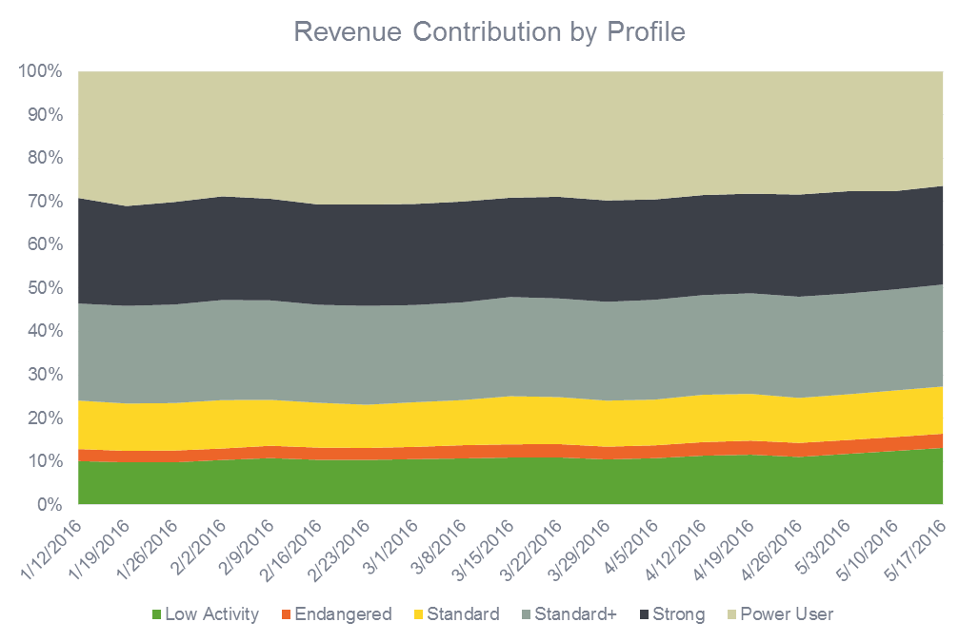
Rfm - Revenue by profile

Slide 15
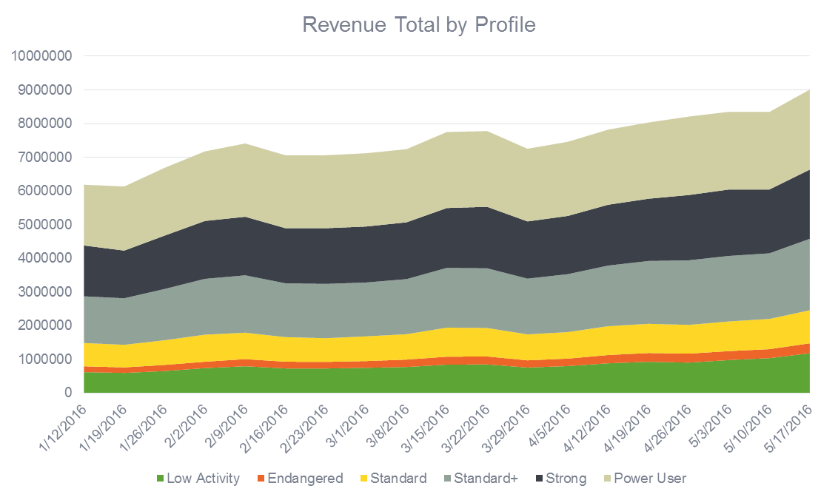
Rfm - Revenue by profile

Slide 16
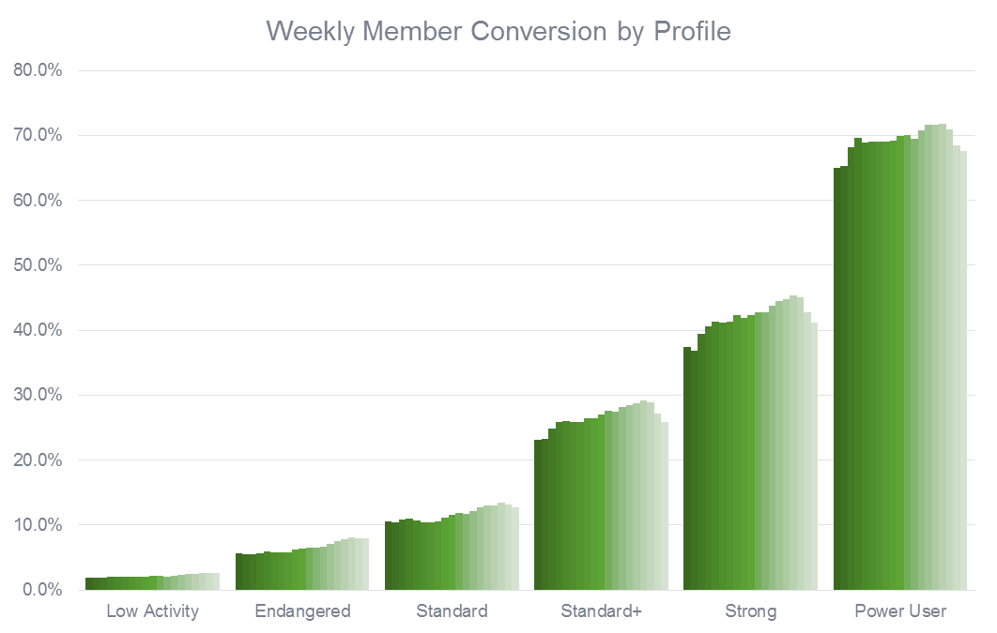
Rfm - Conversion by profile

Slide 17
RFM – Summary statistics
Profile | Members | Active Members | Conversion | Rev/Mem | Res/Mem | Rev/Act Mem | Res/Act Mem
Low Activity | 451,995 | 9,982 | 2.2% | $ 1.82 | 0.03 | $ 82.31 | 1.34
Endangered | 59,257 | 3,868 | 6.5% | $ 3.77 | 0.08 | $ 57.76 | 1.20
Standard- | 114,499 | 13,297 | 11.6% | $ 6.99 | 0.15 | $ 60.20 | 1.29
Standard+ | 103,806 | 27,677 | 26.7% | $ 16.53 | 0.41 | $ 62.00 | 1.55
Strong | 50,167 | 21,055 | 42.0% | $ 34.78 | 0.78 | $ 82.86 | 1.86
Power User | 22,750 | 15,755 | 69.3% | $ 95.56 | 1.93 | $ 137.98 | 2.79
This methodology gives us a nice performance degradation across user profile.
Power Users drive the business
Strong Users provide solid revenue contribution on a bi-weekly basis
Standard+/- users are very similar in terms of driving behavior, the difference is mostly in conversion. i.e., we are capturing these users on different sides of their usage curves
Endangered is the smallest and arguable weakest group – most likely the first area to target
Low activity members represents people on either end of the lifecycle; members just coming on board, or those who have settled on Zipcar as an backup/one-off use case.

Slide 18
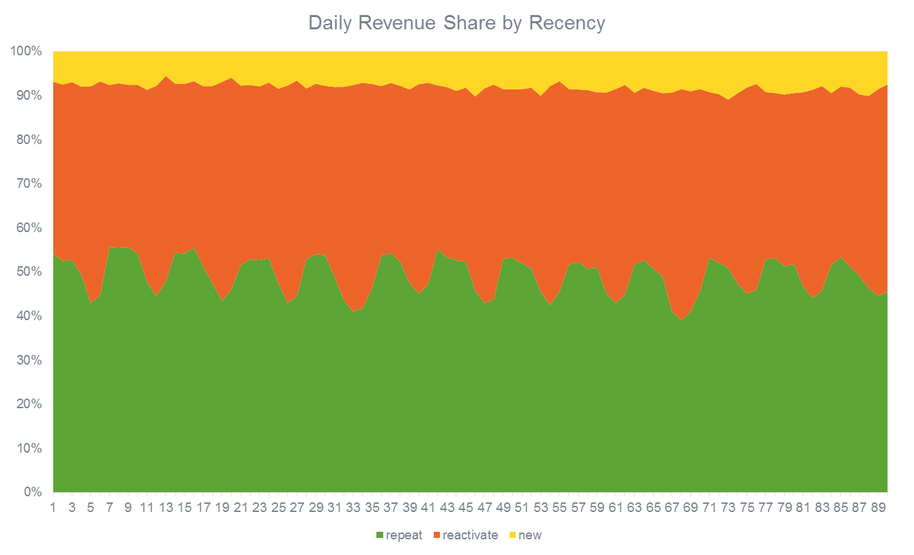
RFM – Recency
We have consolidated the RFM factors down to a single score; but each can be used independent of the others as well. The chart above shows daily revenue contribution by 3 Recency Groups:
Repeat (drove in the past two weeks)
New (New member in the past two weeks)
Reactivate (Everybody else)

Slide 19
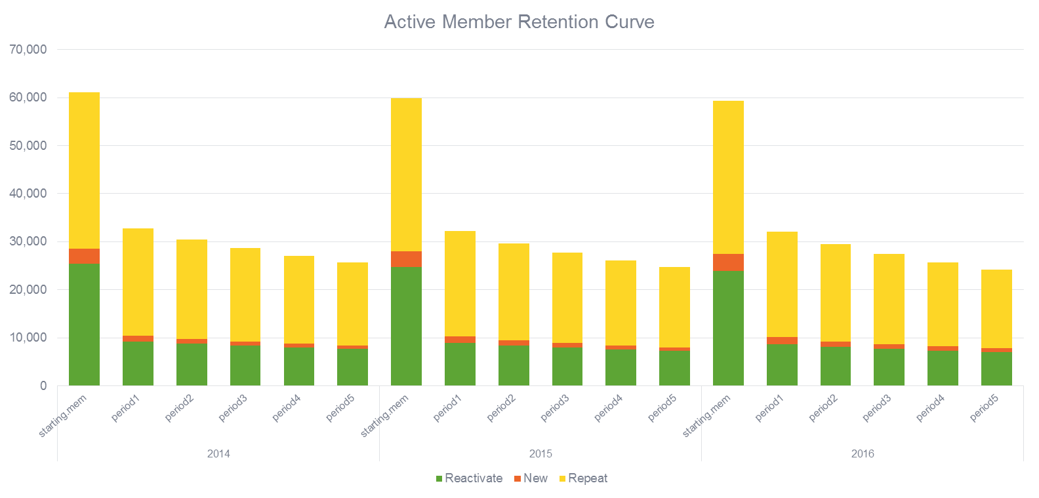
RFM – Recency
Viewing Activity retention curves through this prism also helps understand a drop in performance:
New member 5-period retention is up 4% 2YoY (1%YoY)
Repeat member 5-period retention is down 3% 2YoY (1% YoY)
Reactivated member 5-period retention is down 3% 2YoY (1% YoY)
Reactivated member 1-period retention is down 2.5% 2YoY (1% YoY)

Slide 20
RFM – New member breakdown
One other benefit of the blended score and smaller activity window is the ability for new members to stratify across the profile range out of the gate.
 | Low Activity |  | Standard |  | Standard+ |  | Strong |  | Power User
Observation Date | Existing | New | Existing | New | Existing | New | Existing | New | Existing | New
1/12/2016 | 98.7% | 1.3% | 99.8% | 0.2% | 99.1% | 0.9% | 99.8% | 0.2% | 99.8% | 0.2%
1/19/2016 | 98.1% | 1.9% | 99.5% | 0.5% | 98.0% | 2.0% | 99.4% | 0.6% | 99.6% | 0.4%
1/26/2016 | 97.6% | 2.4% | 99.1% | 0.9% | 97.1% | 2.9% | 99.0% | 1.0% | 99.3% | 0.7%
2/2/2016 | 99.8% | 0.2% | 100.0% | 0.0% | 100.0% | 0.0% | 100.0% | 0.0% | 100.0% | 0.0%
2/9/2016 | 98.8% | 1.2% | 99.7% | 0.3% | 99.2% | 0.8% | 99.8% | 0.2% | 99.9% | 0.1%
2/16/2016 | 98.3% | 1.7% | 99.5% | 0.5% | 97.8% | 2.2% | 99.3% | 0.7% | 99.5% | 0.5%
2/23/2016 | 97.8% | 2.2% | 99.1% | 0.9% | 96.6% | 3.4% | 98.8% | 1.2% | 99.0% | 1.0%
3/1/2016 | 99.9% | 0.1% | 100.0% | 0.0% | 100.0% | 0.0% | 100.0% | 0.0% | 100.0% | 0.0%
3/8/2016 | 99.2% | 0.8% | 99.8% | 0.2% | 99.4% | 0.6% | 99.7% | 0.3% | 99.9% | 0.1%
3/15/2016 | 98.6% | 1.4% | 99.6% | 0.4% | 98.3% | 1.7% | 99.3% | 0.7% | 99.6% | 0.4%
3/22/2016 | 98.1% | 1.9% | 99.2% | 0.8% | 97.1% | 2.9% | 98.8% | 1.2% | 99.1% | 0.9%
3/29/2016 | 97.7% | 2.3% | 98.8% | 1.2% | 95.8% | 4.2% | 98.1% | 1.9% | 98.7% | 1.3%
4/5/2016 | 99.4% | 0.6% | 100.0% | 0.0% | 99.7% | 0.3% | 99.9% | 0.1% | 100.0% | 0.0%
4/12/2016 | 98.7% | 1.3% | 99.7% | 0.3% | 98.8% | 1.2% | 99.7% | 0.3% | 99.8% | 0.2%
4/19/2016 | 98.2% | 1.8% | 99.4% | 0.6% | 97.6% | 2.4% | 99.2% | 0.8% | 99.5% | 0.5%
4/26/2016 | 97.7% | 2.3% | 99.0% | 1.0% | 96.3% | 3.7% | 98.6% | 1.4% | 99.2% | 0.8%
5/3/2016 | 99.7% | 0.3% | 100.0% | 0.0% | 99.9% | 0.1% | 100.0% | 0.0% | 100.0% | 0.0%
5/10/2016 | 99.0% | 1.0% | 99.8% | 0.2% | 99.0% | 1.0% | 99.7% | 0.3% | 99.9% | 0.1%
5/17/2016 | 98.2% | 1.8% | 99.5% | 0.5% | 97.8% | 2.2% | 99.3% | 0.7% | 99.6% | 0.4%
Grand Total | 98.6% | 1.4% | 99.5% | 0.5% | 98.3% | 1.7% | 99.4% | 0.6% | 99.6% | 0.4%

Slide 21
What happens next?
The obvious: Look at the data in more ways
Slice the data by additional dimensions to give a more robust view of the membership
YOY
Business Segment
Rate Plans
Market
Additional data sources

Slide 22
What happens next?
The big picture: Transition to a customer centric marketing approach from a transaction based marketing approach
What does that mean?
Adjust current programs based on learnings
Test and develop new programs
Set new expectations for member activity
Develop new KPIs
Member Marketing Dashboard

